Slide 1
EU – Algeria R&I Coopertaion
Heba Gaber
DG Research & Innovation

Slide 2
Bilateral in the R&I Cooperation in the South MED
Within the European Neighbourhood Partnership Instrument (ENPI) for the period 2007-2013 Research Development and Innovation Programmes dedicated to the South Mediterranean countries support bottom-up capacity building and actions, notably in in Algeria (ESRS, higher education, mobility and research: € 21.5 million), Egypt (RDI: € 11 million for the first programme + € 20 million for its continuation), Jordan (SRTD: € 5 million for the first programme + € 5 million for the second programme), Tunisia (PASRI: € 12 million).
In 2014, the ENPI was replaced by the European Neighbourhood Instrument (ENI), which provides increased support to 16 partner countries to the East and South of the EU’s borders.

Slide 3
EU–Algeria Research and Innovation Cooperation
FP7: Main financial tool through which the EU supported research and development activities covering almost all scientific disciplines (2007-2013).
Algeria in FP7: 214 proposals/43 projects/57 applicants.
EU contribution to the Algerian participants: EUR 3.6 million
Success rate reached 40% in ICT collaborative reach 21% in KBBE; 15% in energy and 22.8 % as an overall success rate which slightly exceeds the average FP7 proposals success rate.
FP7…replaced by H2020 (2014-2020)
Notes:
The European Union is a world leader in research and innovation, responsible for 24% of world expenditure on research, 32% of high impact publications and 32% of patent applications, while representing only 7% of the world population.
Over recent decades the world landscape of research and innovation has evolved rapidly, with emerging economies strengthening their research and innovation systems. The number of scientific publications has increased significantly, yet the European Union has maintained its proportional share of the number of scientific publications.

Slide 4
FP7 - Openness
Researchers from 80 different countries have participated in the immensely successful Marie Skłodowska-Curie actions, while the European Research Council enables top scientists from anywhere in the world to conduct their research in Europe.
More broadly speaking, 20% of projects (over 3000 project) funded under the 7th Framework Programme included at least one international partner in the consortium

Slide 5
Participation in FP7 (2007-2013)
Overall areas of participation (no of projects):

Slide 6
Participation in FP7 (2007-2013)
Most active areas of participation in SP1-Cooperation:

Slide 7
Participation in FP7 (2007-2013)
Most active areas of participation in SP4-Capacities:

Slide 8
Participation in FP7 (2007-2013)
Most active areas of participation by number of applications:
Environment (including Climate Change) | 42
Activities of International Cooperation | 29
Food, Agriculture and Fisheries, and Biotechnology | 28
Socio-economic sciences and Humanities | 24
Marie-Curie Actions | 19
Energy | 16
Health | 15
Research Potential | 14
Information and Communication Technologies | 9
Transport (including Aeronautics) | 6
Research Infrastructures | 6
Nanosciences, Nanotechnologies, Materials and new Production Technologies - NMP | 2
Research for the benefit of SMEs | 2
Science in Society | 2

Slide 9
Most active organizations:
MINISTERE DE L'ENSEIGNEMENT SUPERIEUR ET DE LA RECHERCHE SCIENTIFIQUE
CENTRE DE DEVELOPPEMENT DES ENERGIES RENOUVELABLES
INSTITUT NATIONAL DE LA RECHERCHE AGRONOMIQUE D'ALGERIE
CENTRE DE RECHERCHE EN ECONOMIE APPLIQUEE POUR LE DEVELOPPEMENT
CENTRE DE RECHERCHE SUR L'INFORMATION SCIENTIFIQUE ET TECHNIQUE

Slide 10
Bi-regional cooperation
MedSpring (the Mediterranean Science, Policy, Research and Innovation Gateway) promotes better dialogue between the EU and the Southern Med region on research and innovation, thematic focus - water, food and energy.
ERANETMED - reducing fragmentation of programming in the Mediterranean region by increasing coordination among national research programmes of EU MS, Associated Countries Southern Med countries through innovation and competitive research in the societal challenges of the region. 1st Call: 12 MEUR Topics: Water, Food and Energy
Algeria's contribution to the 1st call of ERANETMET was for the same amount (600 000 euros. Algeria's contribution to the 2nd call of ERANETMED currently under preparation with the theme of - Environmental challenges and solutions for vulnerable communities is forecast at 600 000 euros
Arimnet 2: Coordination of Agricultural Research in the Mediterranean Area
PRIMA: Partnership for Research and Innovation in the Mediterranean Area

Slide 11
Horizon 2020
New Prospects
The New EU Framework Programme for Research and Innovation (2014-2020)

Slide 12
For international cooperation in H2020, the INCO Strategy foresees:
Multi-annual roadmaps for cooperation with countries / regions
Enlargement and neighbourhood countries, and EFTA
Integration in the ERA, creating CKIS, capacity building, coordination with other instruments

Slide 13
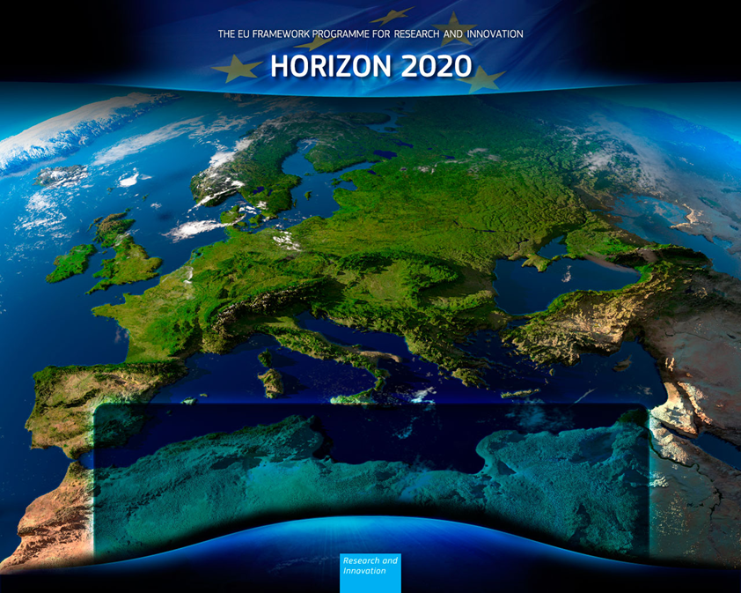
What is Horizon 2020?
A response to economic crisis by investing in future jobs and growth
It addresses people's concerns about their livelihoods, safety and environment
Open to the world
Notes:
Research and innovation have been placed at the centre of the EU budget for the programming period between 2014-20. EU leaders believe strongly that research and innovation will create the economic opportunities of tomorrow.
Horizon 2020, the new programme for research and innovation has been allocated a budget of almost 80 billion euros over the next seven years.
Europe, like much of the world, faces major challenges such as ageing populations and the depletion of natural resources. This affects all of our lives directly, for example through high health care costs, rising energy prices, congested roads, and threats to security.
Horizon 2020 is designed to address these societal challenges through funding excellent science, technology and innovation.
[It is central to the Europe 2020 strategy for smart, sustainable and inclusive growth, the Innovation Union flagship to create a knowledge society, and the goal to complete the European Research Area as a single market for knowledge.]

Slide 14
Euro-Med cooperation in the Horizon
Regional focus – while acknowledging diversity within the region
Focus on common challenges – what are the problems that R&I can help addressing, and how?
Instruments – to support collaborative research, to support R&I policy dialogue, to coordinate initatives by EU, its Member States and MPCs, to integrate programmes/Art 185, to foster innovation !
Building on ongoing projects –e.g. MEDSPRING, ERANET MED

Slide 15
Three Key Pillars
Excellent science
Industrial leadership
Societal challenges

Slide 16
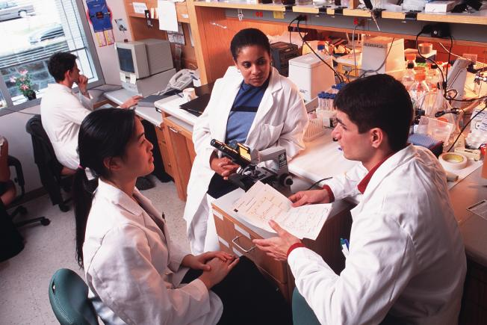
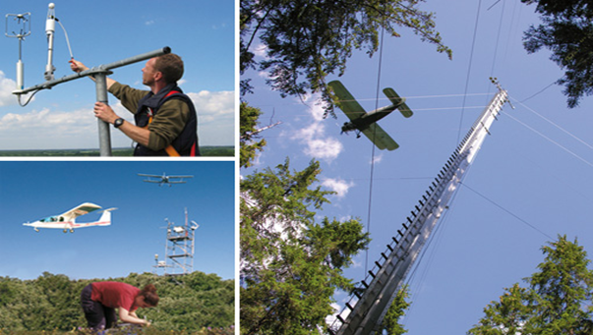
Horizon 2020: Open to the world
General opening
Horizon 2020 is open to participation of researchers and innovators from anywhere in the world, to:
Extend the frontiers of scientific knowledge
Tackle challenges that affect us all
Make industries more competitive
Targeted opening
In certain topics in calls for proposals, inclusion of international partners may be:
encouraged
or
required
Notes:
A New International Strategy
The European Commission's approach to international cooperation has been set out in a Communication in 2012 entitled "Enhancing and focusing EU international cooperation in research and innovation: a strategic approach".
The general openness of Horizon 2020 to the participation of researchers from public and private organisations from across the world is part of this approach.
International Cooperation is therefore mainstreamed across Horizon 2020 to tackle global challenges, promote mobility of researchers and boost the competitiveness of industries

Slide 17
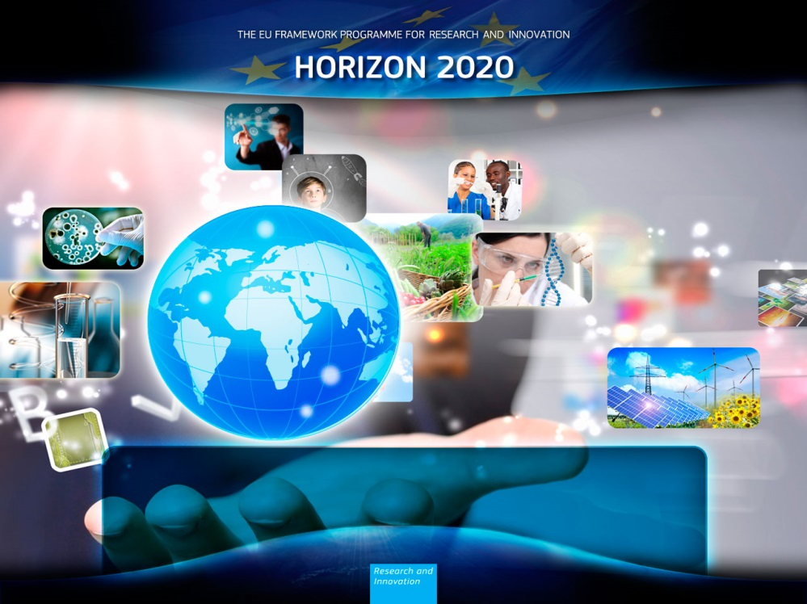
Rules of participation
Applicants from non-EU countries are eligible to take part in Horizon 2020 programmes, even as coordinator
All proposals must meet certain minimum conditions (in Rules for Participation)
ENP countries can participate and receive EC funding (exception: access to risk finance)
Notes:
The Rules of Participation distinguish between eligibility to participate and eligibility for funding.
Eligibility to participate : a legal entity from (almost) anywhere in the world can participate in a consortium as long as the minimum conditions are met (at least 3 legal entities from 3 different EU or Associated countries).
A researcher in an international partner country can even be the coordinator of a research consortium – but the minimum conditions must still be met.
[NOTE: in practice this is very rare since EU researchers have a stronger institutional and national support structure to help them in the preparation of proposals . Also the coordinator is responsible for the financial aspects of the whole project and this is easier in a EU/Associated country.]
For the European Research Council, the applicant must identify in the proposal the host institution in an EU/associated country in which he/she will establish their research group.
For Marie Sklodowska Curie Grants, pre- and post-Doctoral and other positions are published (on Euraxess Jobs Portal) and are open to applicants from anywhere I the world.

Slide 18
Algeria in Horizon 2020

Slide 19
Participation in Horizon 2020 (1)
H2020 attracted 30 Algerian institutions.
4 Projects (2 signed + 2 under preparation) were selected, involving 5 institutions for an EC budgetary contribution of €0.5 million.

Slide 20
Participation in Horizon 2020 (2)

Slide 21
Who participates?

Slide 22
Marie Sklodowska Curie Actions
Marie Sklodowska Curie Actions (MSCA): MSCA actions strengthen international partnerships and research collaboration, by promoting mobility and career development of researchers.
H2020, 2 projects (one signed and one under preparation) participations from Algerian organisations; the "Centre de Recherches Scientifique et Technique en Analyses Physico-Chimiques" and "Université Alger 2", have been funded in Research and Innovation Staff Exchanges (RISE) and Individual fellowships (IF) actions.

Slide 23
Europe in a Changing World
RINEA (2015-2018) is the new EU-Africa INCONET . The project "Research and Innovation Network for Europe and Africa" (RINEA) proposes three specific objectives:
Strengthening the quality and quantity of partnerships between research and innovation stakeholders in EU Member states, in Associated Countries and in countries in Africa
Encouraging transnational coordination of programmes and policies for international cooperation in STI for greater coherence, joint ownership and resource efficiency
Supporting and enriching processes of bi‐regional STI policy dialogue between the EU-Africa

Slide 24
List of Projects
Project Acronym | [PJ] Topic Unique Programme Part Description | Participant Requested EC Contribution
EXANDAS | Marie-Sklodowska-Curie Actions | 216,000
STUSOCSTA | Marie-Sklodowska-Curie Actions | 152,377
RINEA | Europe in a changing world - inclusive, innovative and reflective societies | 67,656
5TOI_4EWAS | Europe in a changing world - inclusive, innovative and reflective societies | 56,600
5TOI_4EWAS | Europe in a changing world - inclusive, innovative and reflective societies | 55,375

Slide 25
New Prospects: WP 2016 - 2017

Slide 26
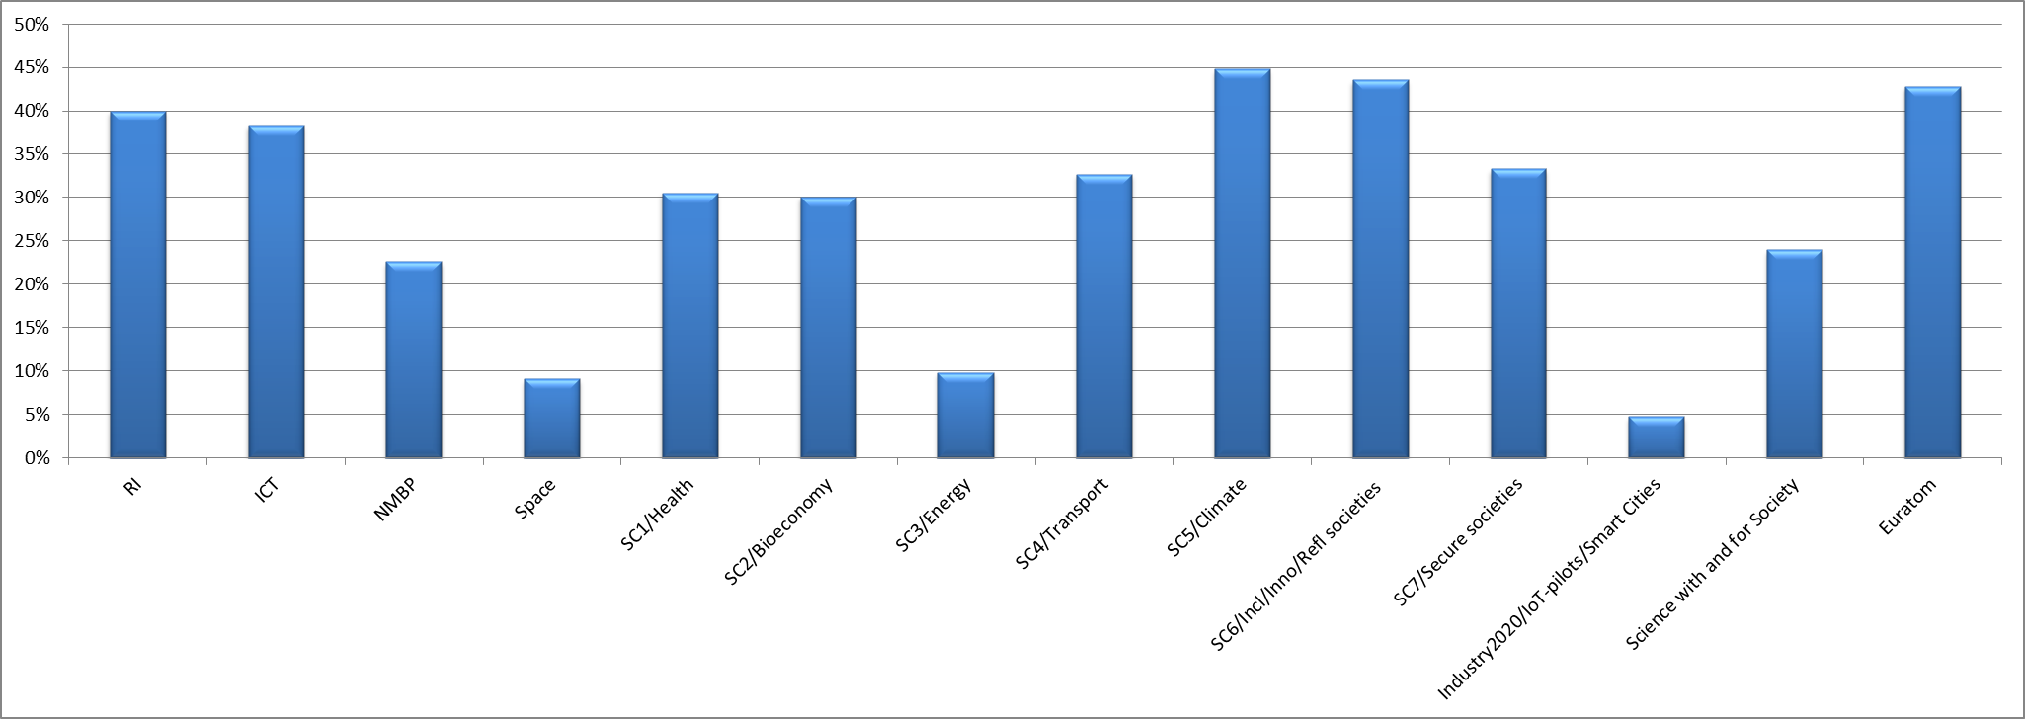
27% of all topics in WP 2016-17 flagged as specifically relevant for international cooperation

Slide 27
How to take Part? Participant Portal

Slide 28
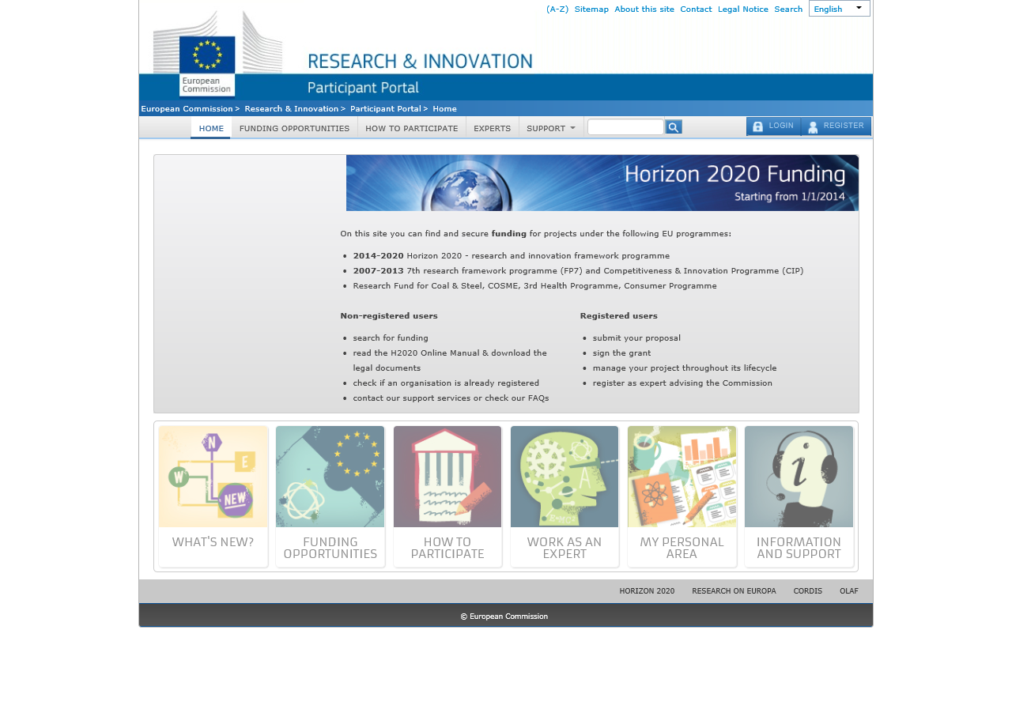
http://ec.europa.eu/research/participants/portal/desktop/en/home.html

Slide 29
Where to find more information and where to apply?
Horizon 2020 Participant Portal Research and Innovation European Commission http://ec.europa.eu/research/participants/portal/desktop/en/home.html
Horizon 2020 European Commission http://ec.europa.eu/programmes/horizon2020/
Incontact (NCP's network) http://www.ncp-incontact.eu/nkswiki/index.php?title=Main_Page
Notes:
All relevant information on Horizon 2020 can be found online. The Participant Portal contains all the necessary documents and online manuals to help you understand Horizon 2020 and how to apply.
You can always direct your questions to the National Contact Points, our NCP Network present around the world.

Slide 30
HORIZON 2020
Open to the world!
Thank You!
Find out more:
www.ec.europa.eu/horizon2020

